Slide 1
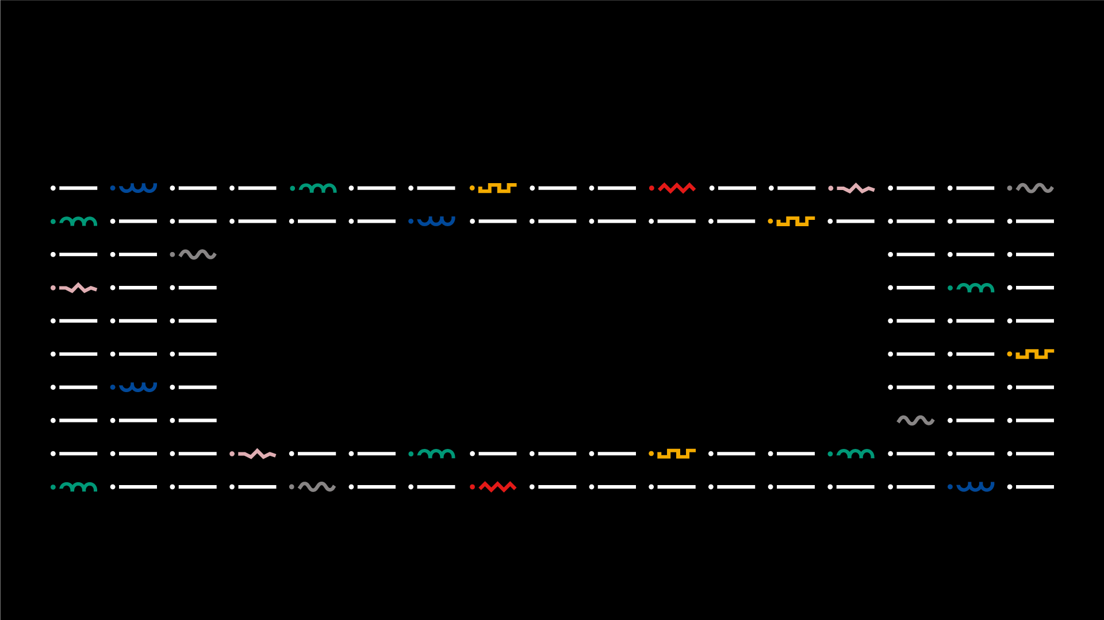




WebSIG Viewer For Geographic Data
Graduation IN Informatics engineering
WebSIG viewer for geographic data
■ Course Unit: System Integration
António Marques - 21674
Nelson Campinho - 21751
■ Coordinator: Prof. Coordenador Jorge Ribeiro
Instituto Politécnico de Viana do Castelo
Escola Superior de Tecnologia e Gestão
www.ipvc.pt
School Year: 2020/2021
Orientation
Coordinator: Prof. Coordenador Jorge Ribeiro
21674 – António José Ribeiro Marques
21751 – Nelson Filipe Faria Campinho
Graduation in Informatics Engineering | Escola Superior de Tecnologia e Gestão| Course Unit: System Integration | School Year: 2020/2021

Slide 2
Graduation IN Informatics engineering
■ Summary
System Integration
1. Introduction and Objectives
2. Technologies, tools, libraries, methodology and project management
2.1 Programming Environment
2.2 Project Architecture
3. PostgreSQL and GeoServer
3.1. PostgreSQL installation
3.1.1. Tables and Queries
3.1.2. Shapefiles
3.2. QGIS
3.2. GeoServer
4. OpenLayers Example
5. Final Project – WebSIG Viewer
5.1. PostgreSQL, Geoserver and openstreetmaps
5.1.1. Database Connection and Inserting data
5.1.2. Getting inserted data
5.1.3. Removing inserted data
6. Difficulties & future features
7. Conclusion
8. Bibliography and Web References
@2020/2021 – António Marques – 21674 and Nelson Campinho – 21751 – WebSIG viewer for geograpic data
- 2 -

Slide 3
Graduation IN Informatics engineering
■ 1. Introduction and Objectives
System Integration
■ Maps represent a huge source of information for the viewer. They show different streets, ground elevations, rivers, borders and other types of information in order to provide its viewers with enough data to become useful. When maps became digital, representation possible using geographic data and constructing the maps using layers, the amount of information that could be provided increased greatly and its usage became more accessible.
@2020/2021 – António Marques – 21674 and Nelson Campinho – 21751 – WebSIG viewer for geograpic data
- 3 -

Slide 4
Graduation IN Informatics engineering
■ 1. Introduction and Objectives
System Integration
■ The main objective of this project is to create a WebSIG, by using an open-source map provider alonside a database that supports storage and usage of geographic related opetations, to implement multiple features related to positions. To the open-souce is going to be implemented features that allow the insertion, editing and visualization of data on the map.
@2020/2021 – António Marques – 21674 and Nelson Campinho – 21751 – WebSIG viewer for geograpic data
- 4 -

Slide 5









Graduation IN Informatics engineering
■ 2.Technologies, tools and libraries
Project III
@2020/2021 – António Marques – 21674 and Nelson Campinho – 21751 – WebSIG viewer for geograpic data
- 5 -
- 5 -

Slide 6
Graduation IN Informatics engineering
■ 2.2. Project Architecture
System Integration
@2020/2021 – António Marques – 21674 and Nelson Campinho – 21751 – WebSIG viewer for geograpic data
- 6 -

Slide 7
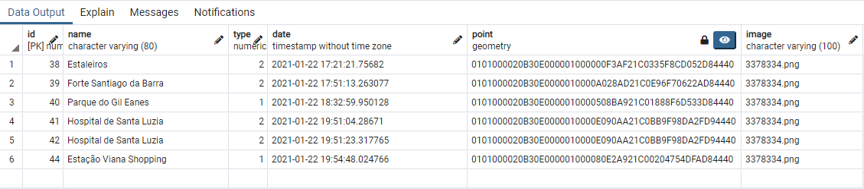
Graduation IN Informatics engineering
■ 3. PostgreSQL and GeoServer
System Integration
■ PostgreSQL is an open-source relational database system that is compatible with operation relating to geographic information, allowing to perform not on the regular queries that any database system allows but also to performs queries to tables that contain geographic information. These operations are enables because of PostGIS
Geometry enabled with postgis
@2020/2021 – António Marques – 21674 and Nelson Campinho – 21751 – WebSIG viewer for geograpic data
- 7 -

Slide 8
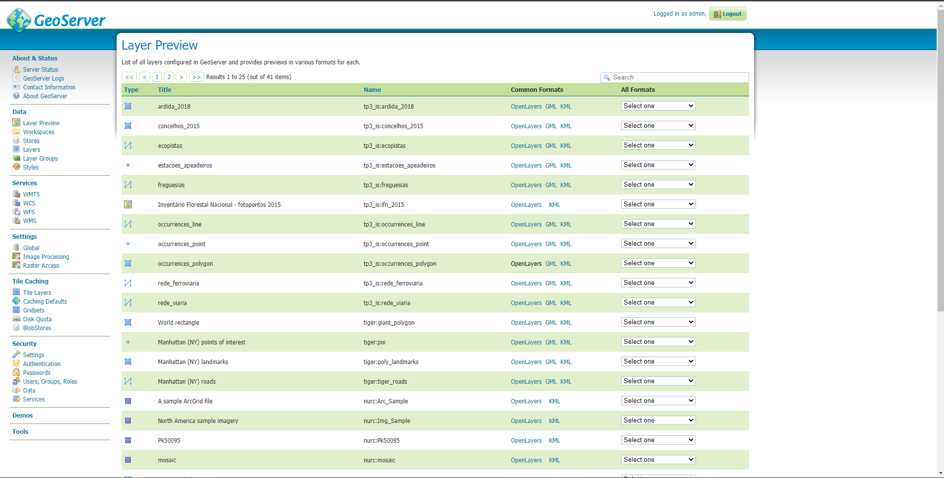
Graduation IN Informatics engineering
■ 3. PostgreSQL and GeoServer
System Integration
■ In order to allow the open-source map to interact with data provided by PostgreSQL a server, that it’s also compatible with geographic data, is required. Such server used on the project is GeoServer. It uses information contained on the database to create layers that later are imported into the map (depending on the task performed on the map) and renders it.
@2020/2021 – António Marques – 21674 and Nelson Campinho – 21751 – WebSIG viewer for geograpic data
- 8 -

Slide 9
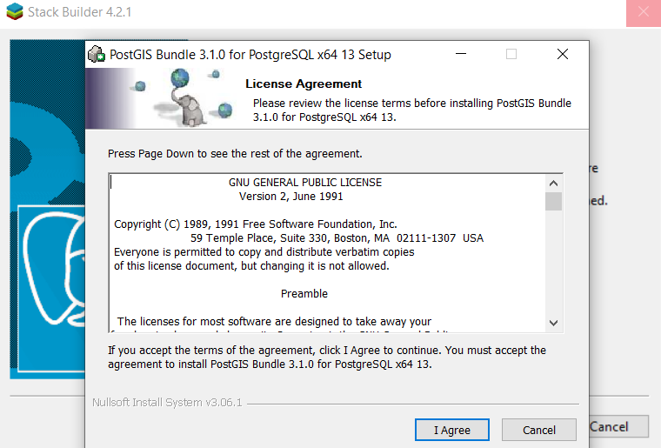
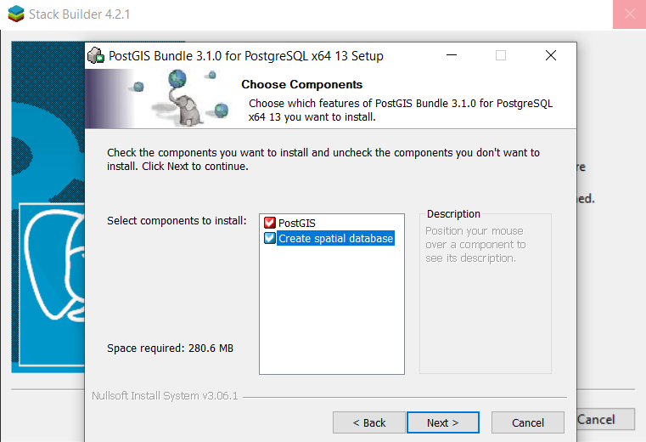
Graduation IN Informatics engineering
■ 3.1. PostgreSQL installation
System Integration
This chapter is dedicated to the installation of PostgreSQL and enabling PostGIS
Enabling PostGis to allow geographic queries and data
@2020/2021 – António Marques – 21674 and Nelson Campinho – 21751 – WebSIG viewer for geograpic data
- 9 -

Slide 10
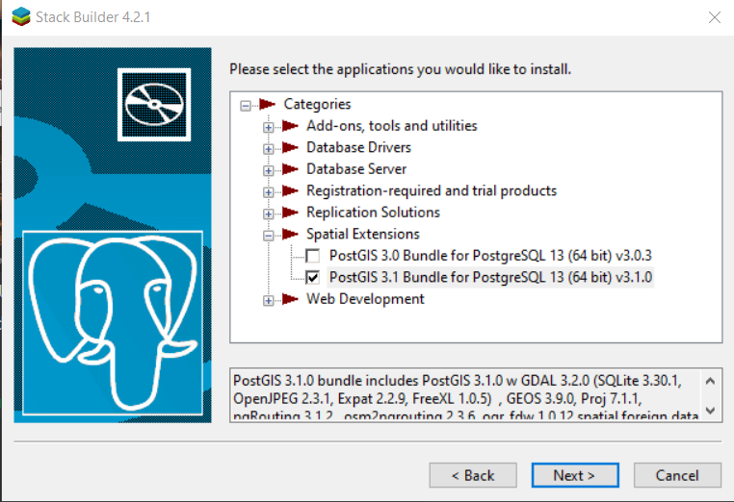
Graduation IN Informatics engineering
■ 3.1. PostgreSQL installation
System Integration
@2020/2021 – António Marques – 21674 and Nelson Campinho – 21751 – WebSIG viewer for geograpic data
- 10 -

Slide 11
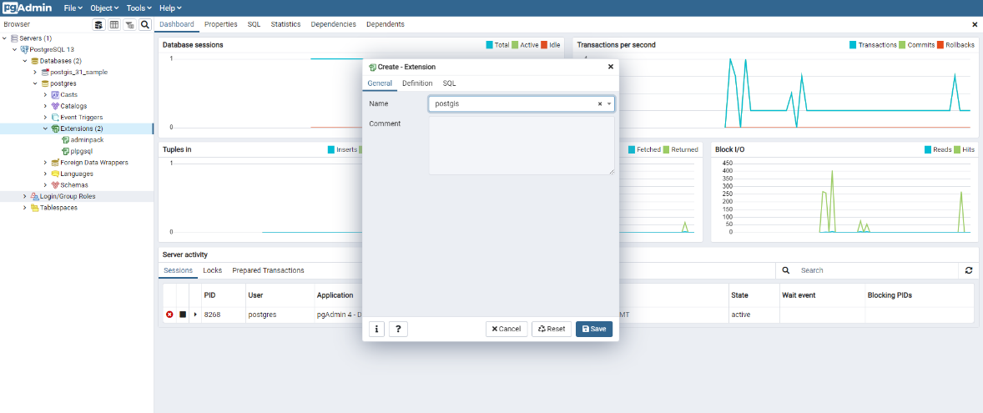
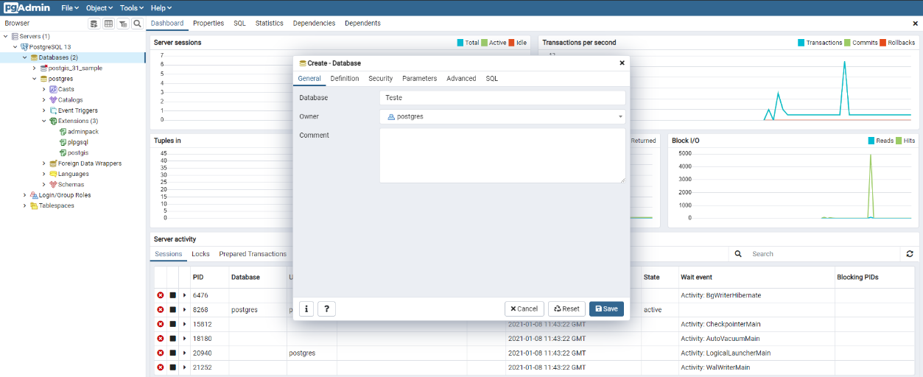
Graduation IN Informatics engineering
■ 3.1. PostgreSQL installation
System Integration
Activating installed PostGIS
Creating database for the project
@2020/2021 – António Marques – 21674 and Nelson Campinho – 21751 – WebSIG viewer for geograpic data
- 11 -

Slide 12
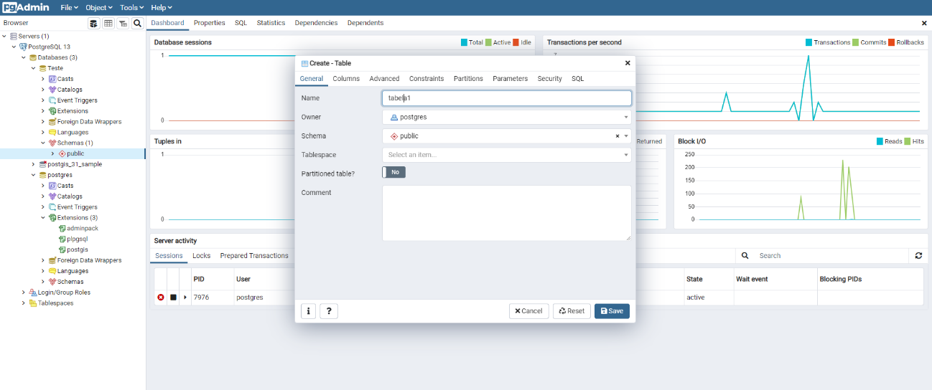
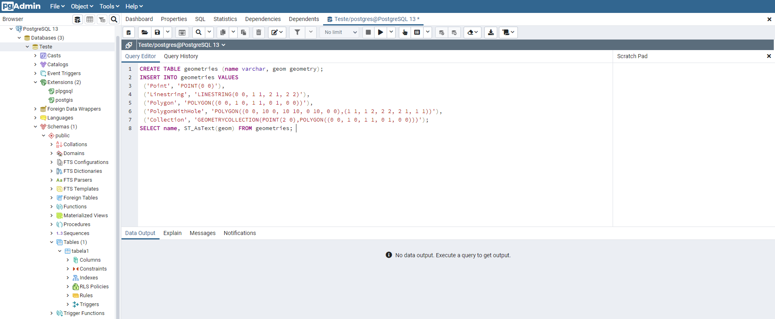
Graduation IN Informatics engineering
■ 3.1.1. Tables and Queries
System Integration
Creating table. This table is going to serve as an example for how PostgreSQL displays geographic data
Inserting into the table previously created data that creates a point, line, polygons and collections
Selecting geometry table fields in string format
@2020/2021 – António Marques – 21674 and Nelson Campinho – 21751 – WebSIG viewer for geograpic data
- 12 -

Slide 13
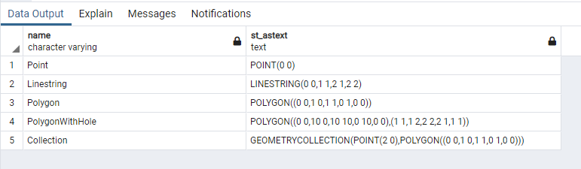
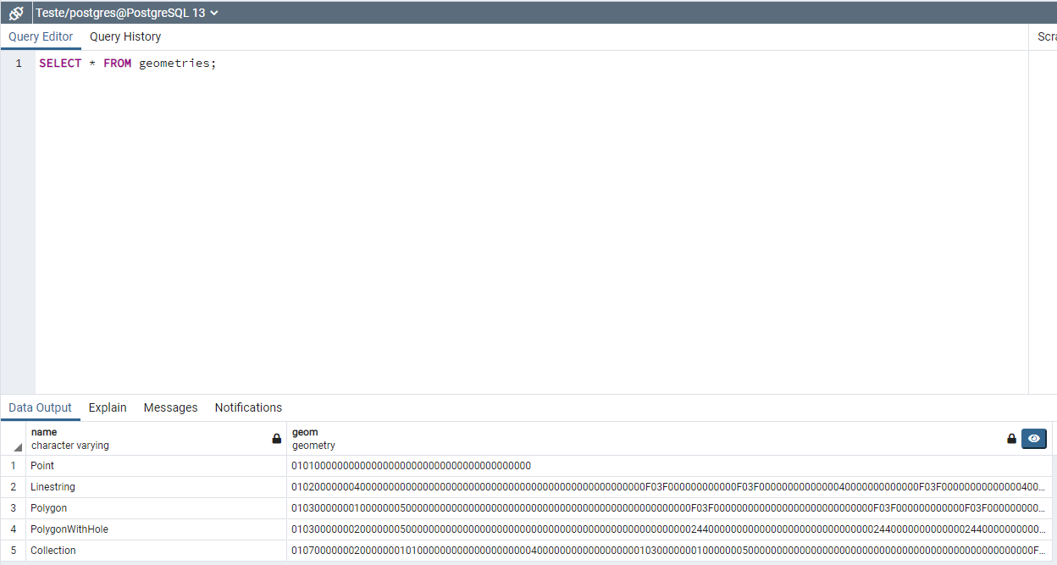
Graduation IN Informatics engineering
■ 3.1.1. Tables and Queries
System Integration
Output from the select
Allows graphic visualization of query results
Output of geometry fields in geometry format
@2020/2021 – António Marques – 21674 and Nelson Campinho – 21751 – WebSIG viewer for geograpic data
- 13 -

Slide 14
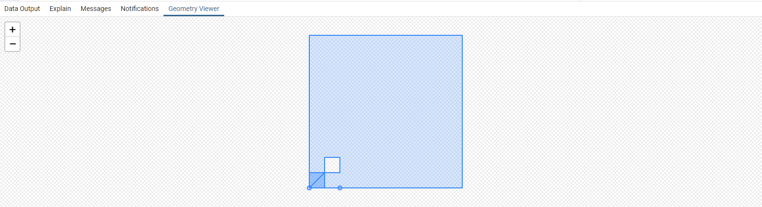
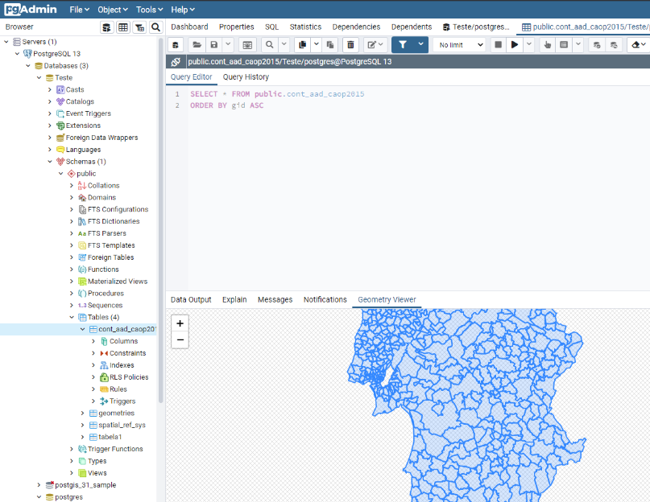
Graduation IN Informatics engineering
■ 3.1.2. Shapefiles
System Integration
Geometry Viewer shows the representation of the geometry fields. The image it generates represents the layer that would be applied to a map.
Shape file gotten from data.gov website. This shape file contains information about Portugal’s countries.
The visual representation of the shape file represents all Portuguese territory where each county boundaries are outlined
@2020/2021 – António Marques – 21674 and Nelson Campinho – 21751 – WebSIG viewer for geograpic data
- 14 -

Slide 15
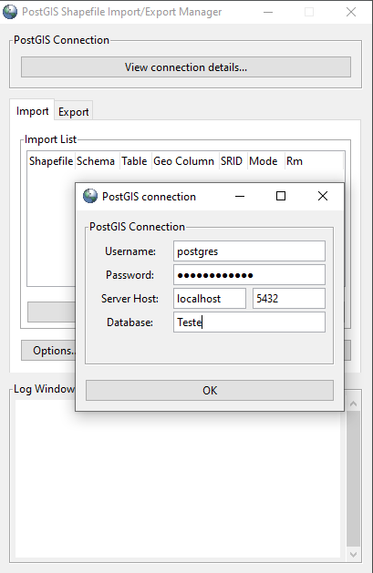
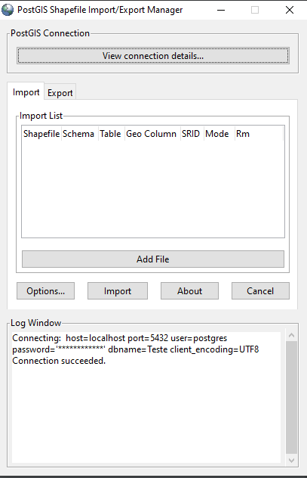
Graduation IN Informatics engineering
■ 3.1.2. Shapefiles
System Integration
A way to import files into PostgreSQL’s pgAdmin is by using PostGIS. In order to do that perform a connection is required.
Connection successfull
Add a shape file to PostGIS
@2020/2021 – António Marques – 21674 and Nelson Campinho – 21751 – WebSIG viewer for geograpic data
- 15 -

Slide 16
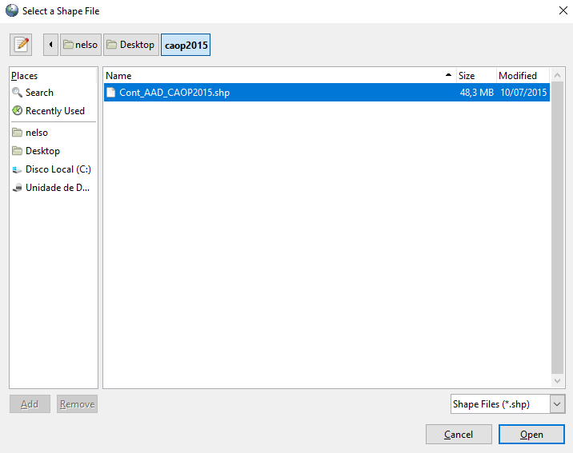
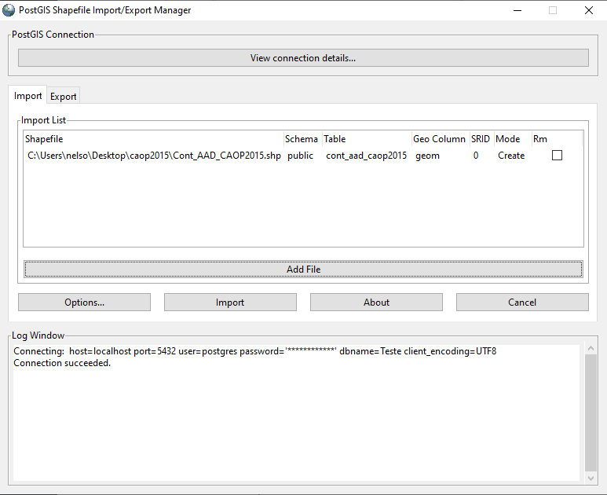
Graduation IN Informatics engineering
■ 3.1.2. Shapefiles
System Integration
Shapefiles represent a data format that stores the geometric location and attribute information of geographic features. Geographic features can be represented by points, lines or polygons.
With the shapefile previously downloaded from data.gov website, it is imported using PostGIS to pgAdmin.
Shapefile transfer via PostGIS. These files create tables on PostgreSQL
@2020/2021 – António Marques – 21674 and Nelson Campinho – 21751 – WebSIG viewer for geograpic data
- 16 -

Slide 17
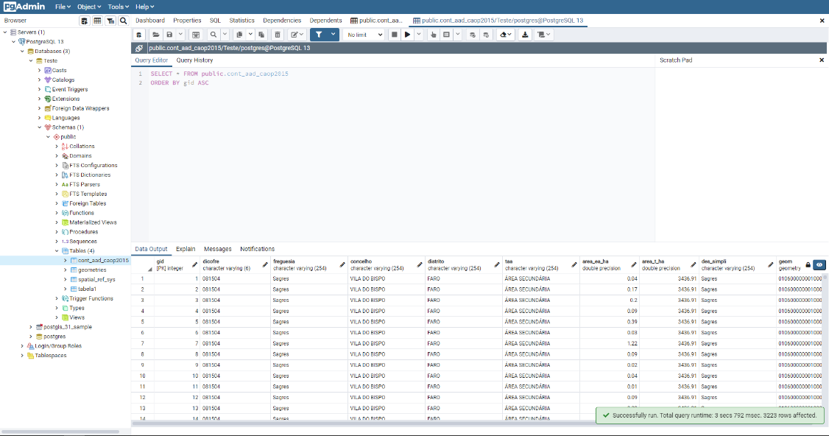
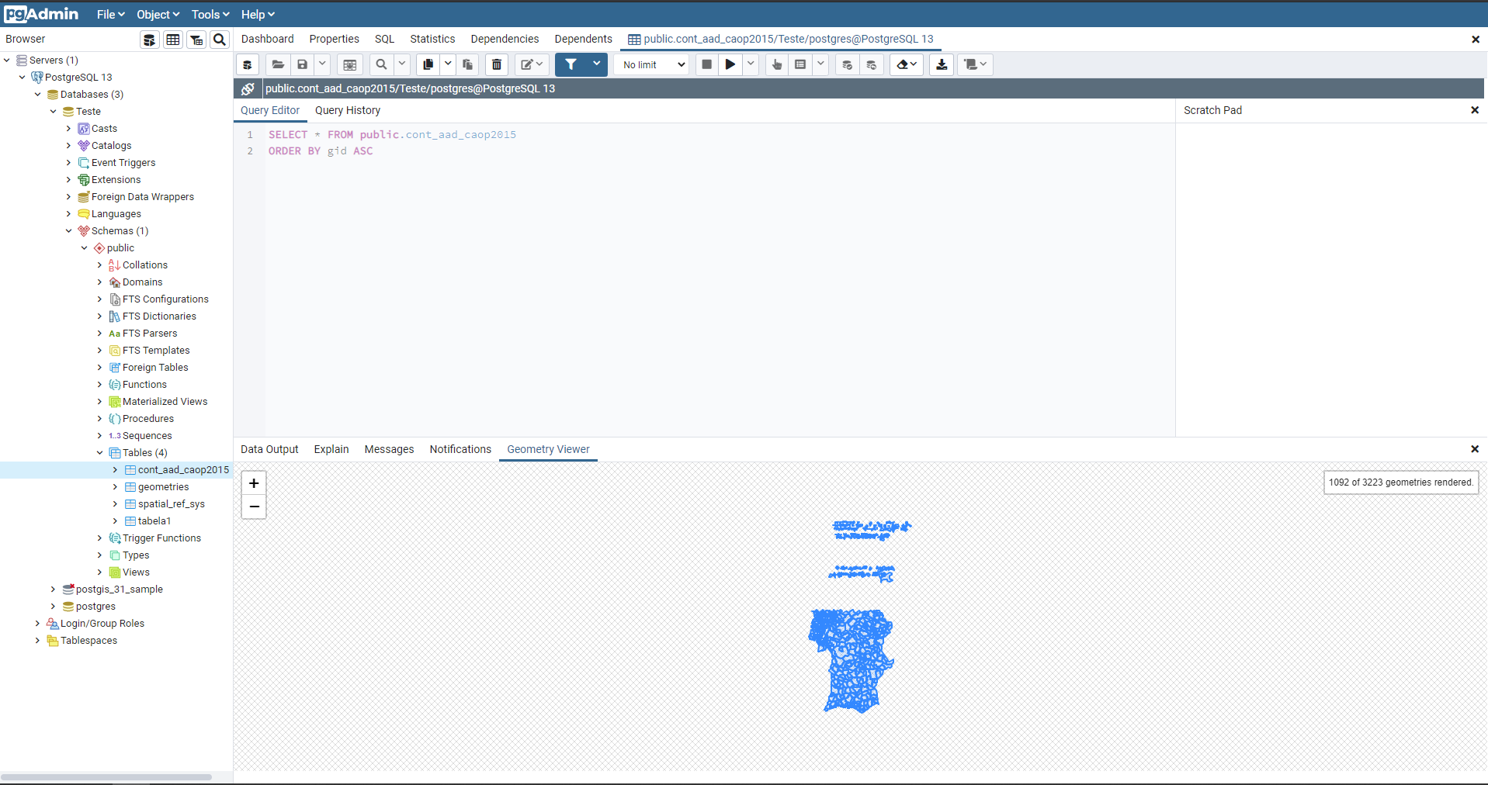
Graduation IN Informatics engineering
■ 3.1.2. Shapefiles
System Integration
With the same example from slide 14, we can verify the different types of information that the shapefile contains.
Shapefile map visualization. Represents the layer that could be imported into a map
@2020/2021 – António Marques – 21674 and Nelson Campinho – 21751 – WebSIG viewer for geograpic data
- 17 -

Slide 18
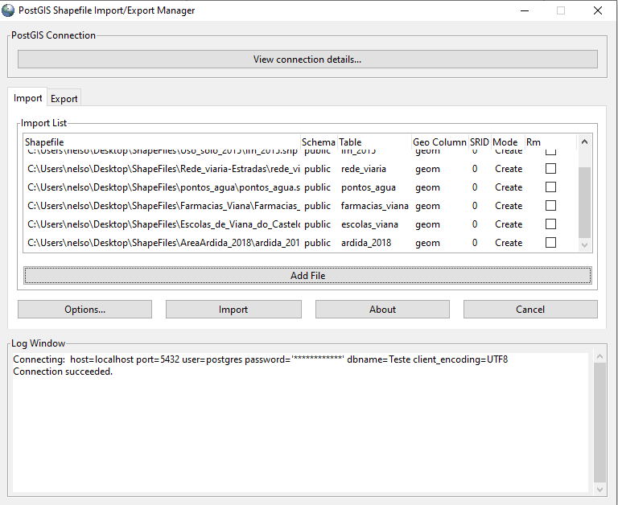
Graduation IN Informatics engineering
■ 3.1.2. Shapefiles
System Integration
Import of multiple shapefiles from data.gov.
@2020/2021 – António Marques – 21674 and Nelson Campinho – 21751 – WebSIG viewer for geograpic data
- 18 -

Slide 19
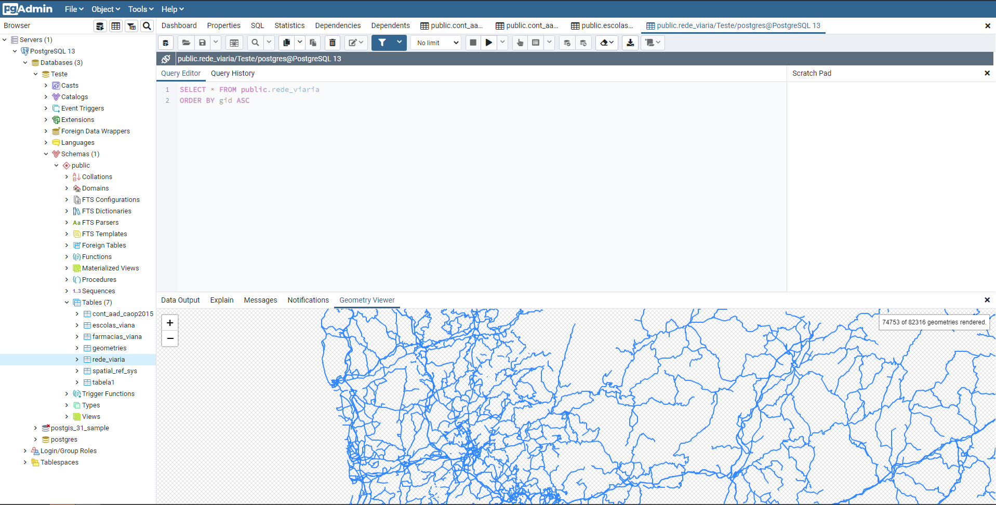
Graduation IN Informatics engineering
■ 3.1.2. Shapefiles
System Integration
The following image represents the Geometry viewer from the shapefile that contains information about Portugal’s road network.
@2020/2021 – António Marques – 21674 and Nelson Campinho – 21751 – WebSIG viewer for geograpic data
- 19 -

Slide 20
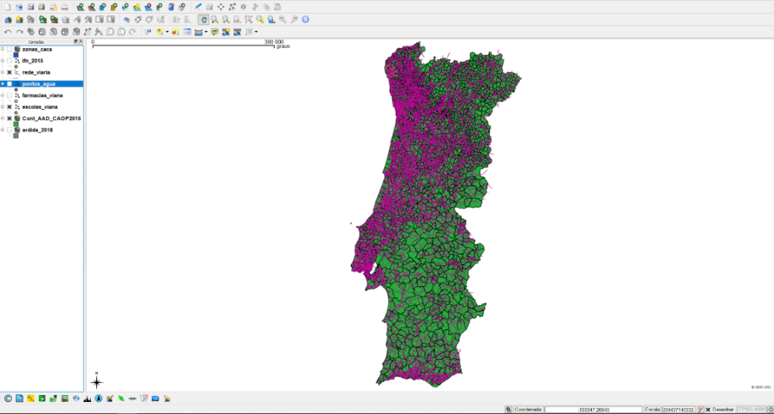
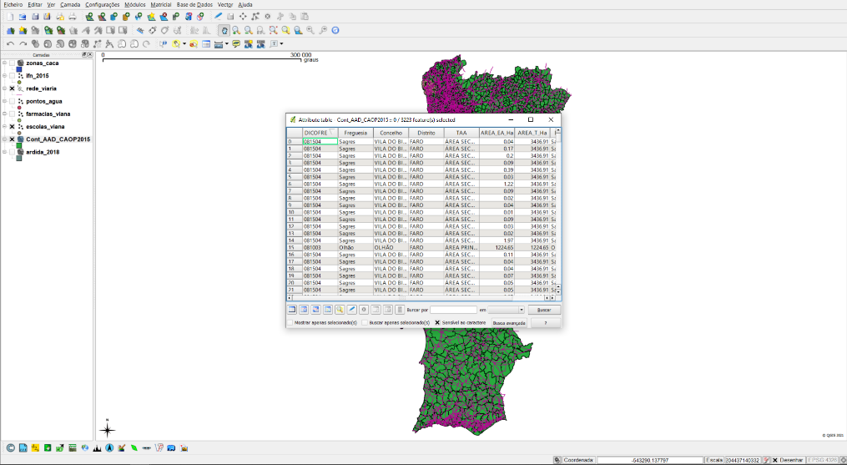
Graduation IN Informatics engineering
■ 3.2. QGIS
System Integration
Other ways of exploring and analyzing shapefiles is by using other open-source tools that support goespacial data. One of those tools is QGIS.
Shapefiles with information about water spots
Shapefiles about countries
@2020/2021 – António Marques – 21674 and Nelson Campinho – 21751 – WebSIG viewer for geograpic data
- 20 -

Slide 21
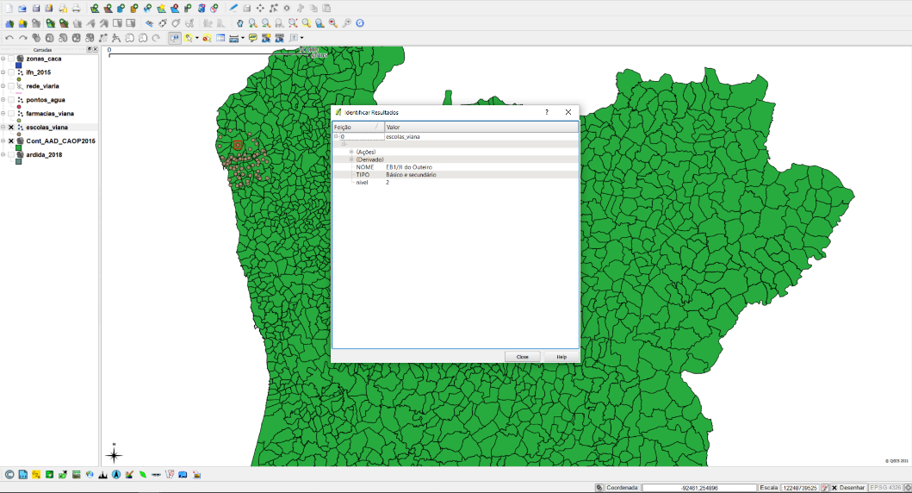
Graduation IN Informatics engineering
■ 3.2. QGIS
System Integration
QGIS has multiple features that use the data contained on the shapefiles to, for example, present personalized information about each point, line or polygon rendered using the shapefile
Points that represent schools from Viana’s district
Selected point information
@2020/2021 – António Marques – 21674 and Nelson Campinho – 21751 – WebSIG viewer for geograpic data
- 21 -

Slide 22
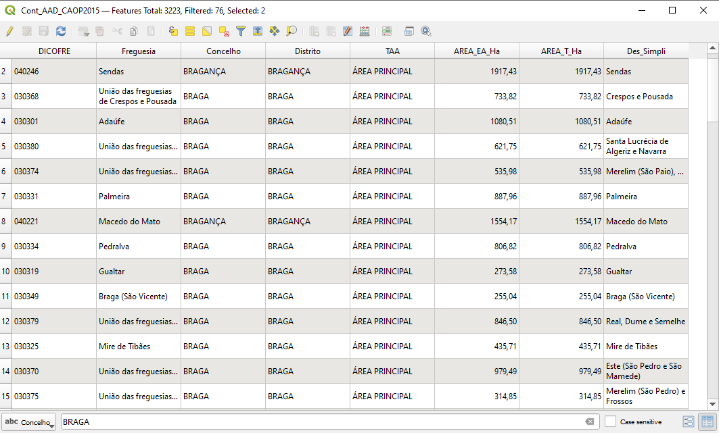
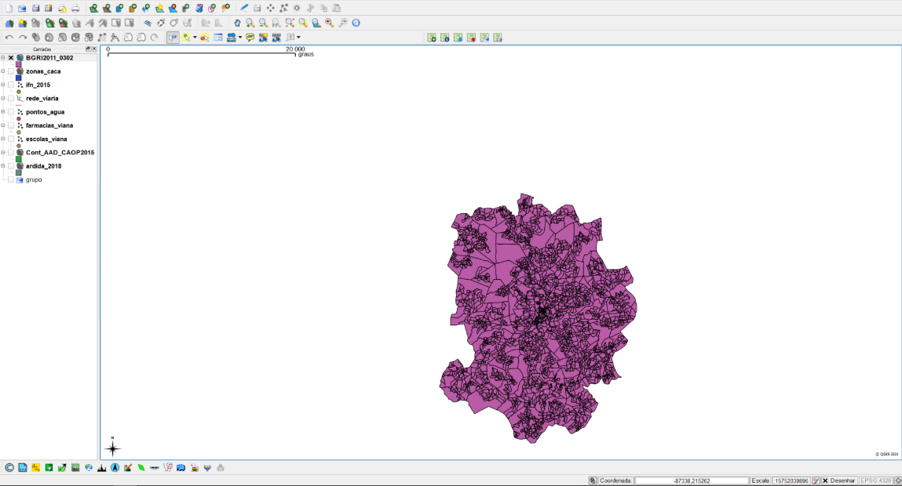
Graduation IN Informatics engineering
■ 3.2. QGIS
System Integration
By installing plugins on QGIS it is possible to perform searches to data on shapefiles and present only the geospacial visualization of the result. Result from ‘Braga’ search.
@2020/2021 – António Marques – 21674 and Nelson Campinho – 21751 – WebSIG viewer for geograpic data
- 22 -

Slide 23
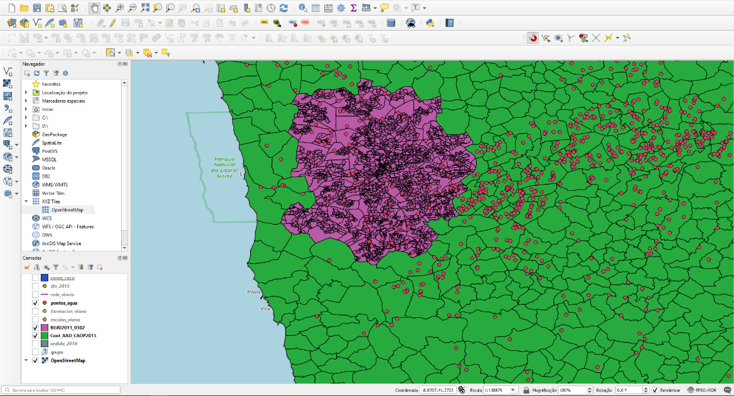
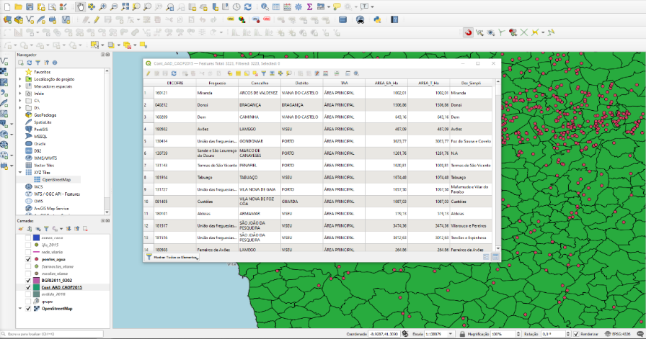
Graduation IN Informatics engineering
■ 3.2. QGIS
System Integration
All the information that appears on QGIS uses the same line of thought of regular open-source maps that can be freely used. Each information relative to a shapefile is rendered on the top of each other by layers.
Layer 3
Information on purple area
Layer 1
Layer 2
@2020/2021 – António Marques – 21674 and Nelson Campinho – 21751 – WebSIG viewer for geograpic data
- 23 -

Slide 24
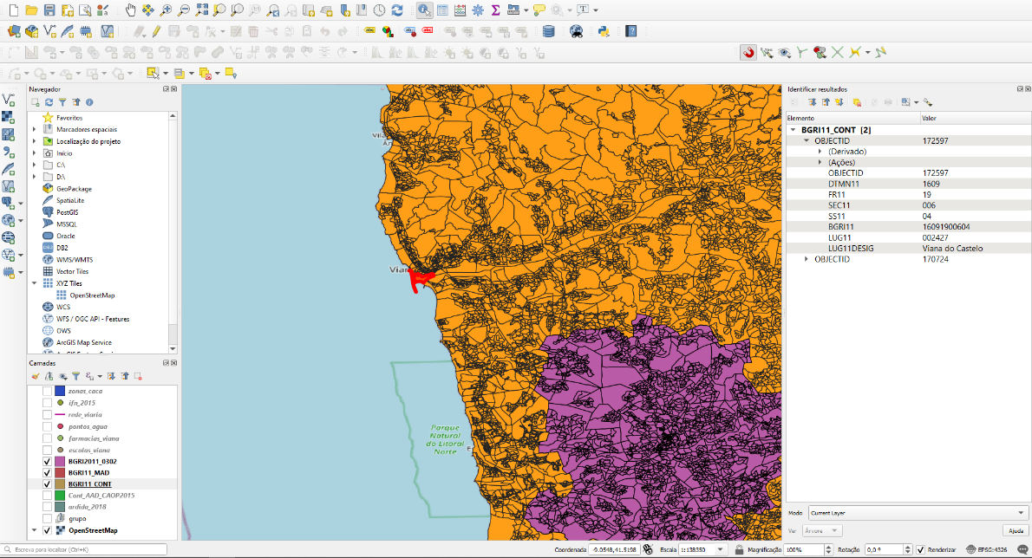
Graduation IN Informatics engineering
■ 3.2. QGIS
System Integration
Information related to the selected area
@2020/2021 – António Marques – 21674 and Nelson Campinho – 21751 – WebSIG viewer for geograpic data
- 24 -

Slide 25
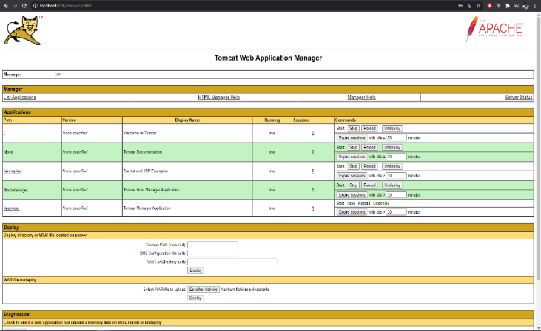
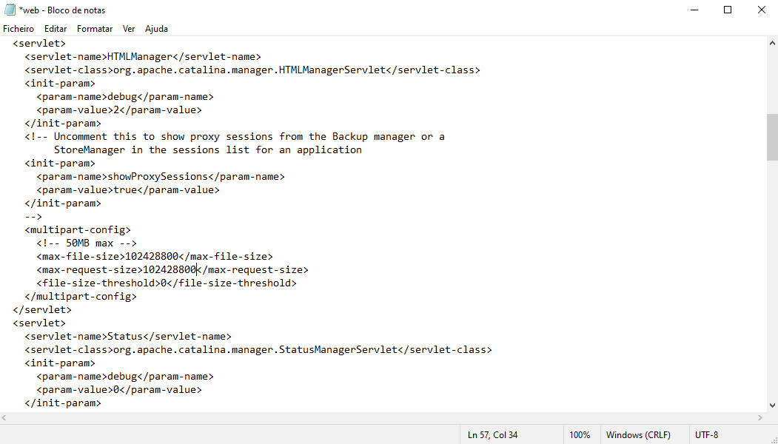
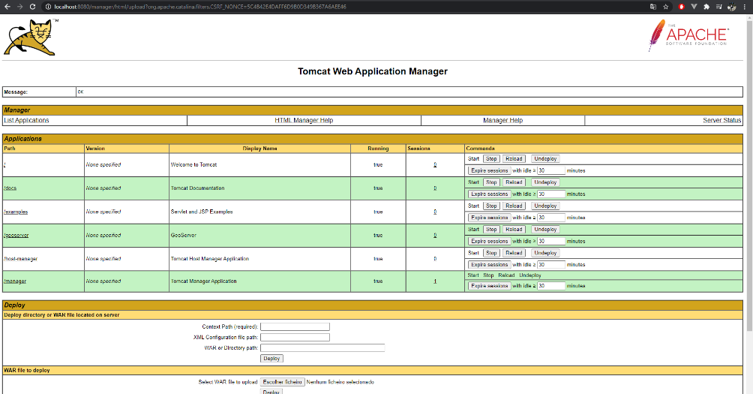
Graduation IN Informatics engineering
■ 3.3. Geoserver
System Integration
To use Geoserver it is required to incorporate it on tomcat. To do so the size that tomcat allows to import war files needs to be increased.
@2020/2021 – António Marques – 21674 and Nelson Campinho – 21751 – WebSIG viewer for geograpic data
- 25 -

Slide 26
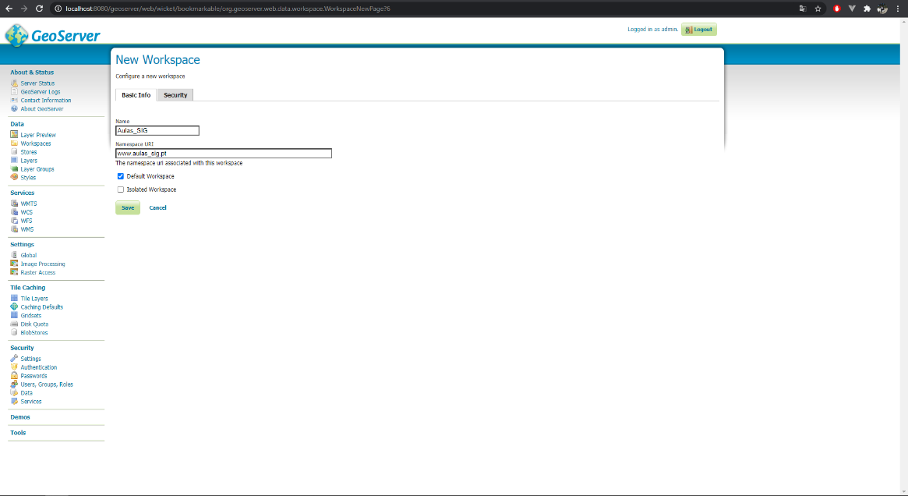
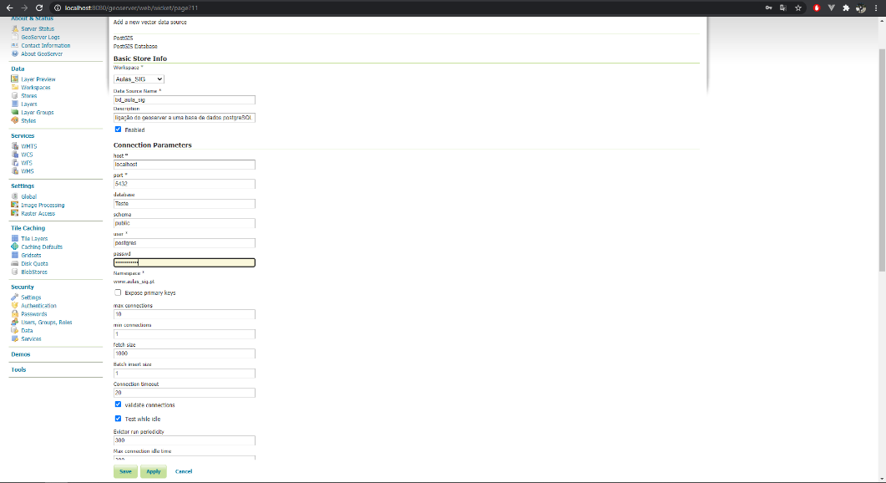
Graduation IN Informatics engineering
■ 3.3. Geoserver
System Integration
On geoserver can be created a new geoserver workspace that it’s going to be incorporated alongside PostgreSQL.
Creation of the store is necessary to hold information about a layer that represents the geometry rendering of the information contained on a shape file. These shape files are contained on PostgreSQL
@2020/2021 – António Marques – 21674 and Nelson Campinho – 21751 – WebSIG viewer for geograpic data
- 26 -

Slide 27
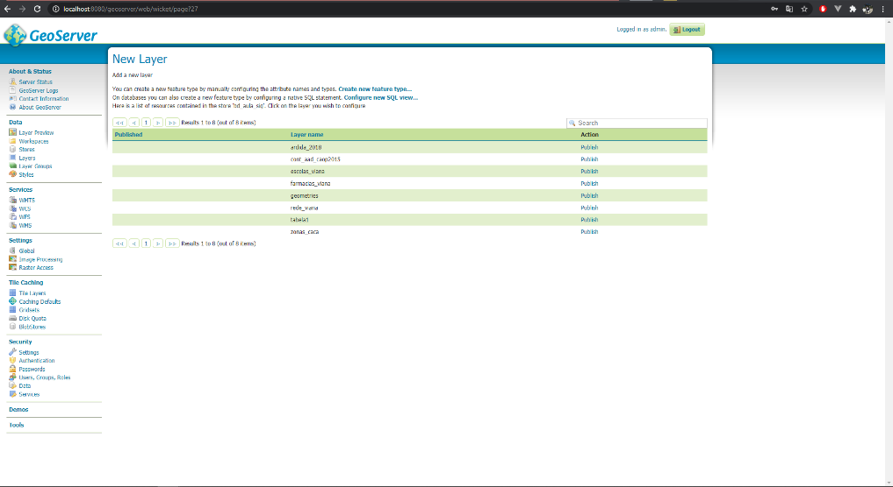
Graduation IN Informatics engineering
■ 3.3. Geoserver
System Integration
On the following image each layer represents the previously explored shapefiles obtained from data.gov. Geoserver contains layers for Portugal’s road network, counties, schools from Viana district and others.
Publish the layer
@2020/2021 – António Marques – 21674 and Nelson Campinho – 21751 – WebSIG viewer for geograpic data
- 27 -

Slide 28
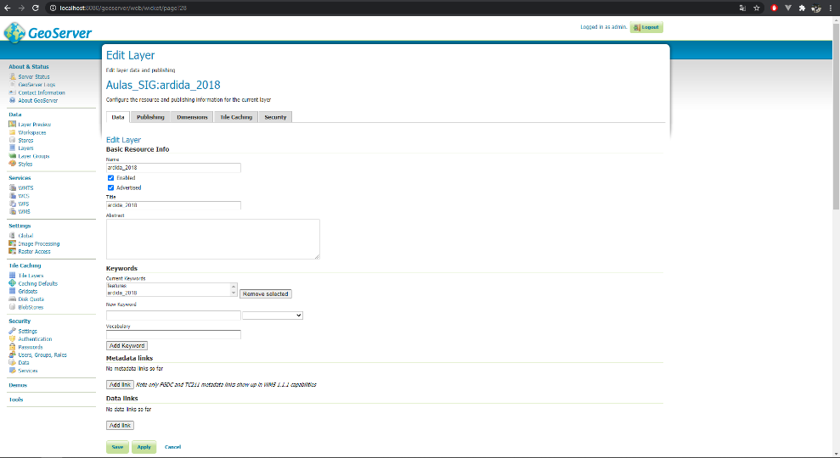
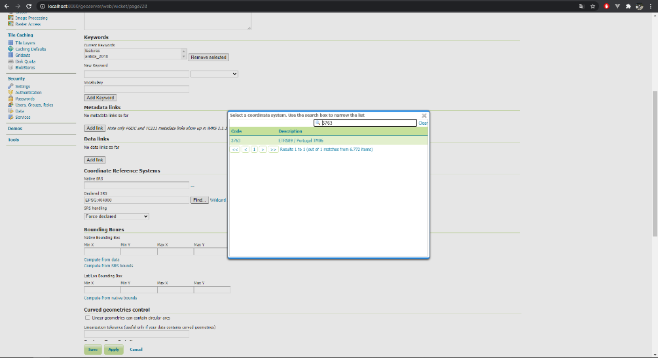
Graduation IN Informatics engineering
■ 3.3. Geoserver
System Integration
The layers contained on the Geoserver can also be edited. One of the edit and probably one of the most important ones is to make sure that all layers use the same coordinate system or else some layers may appear on the map because of it.
In this case the coordinate system that is going to be used is 3763 (Portuguese coordinate system).
Selected layer
Workspace
@2020/2021 – António Marques – 21674 and Nelson Campinho – 21751 – WebSIG viewer for geograpic data
- 28 -

Slide 29
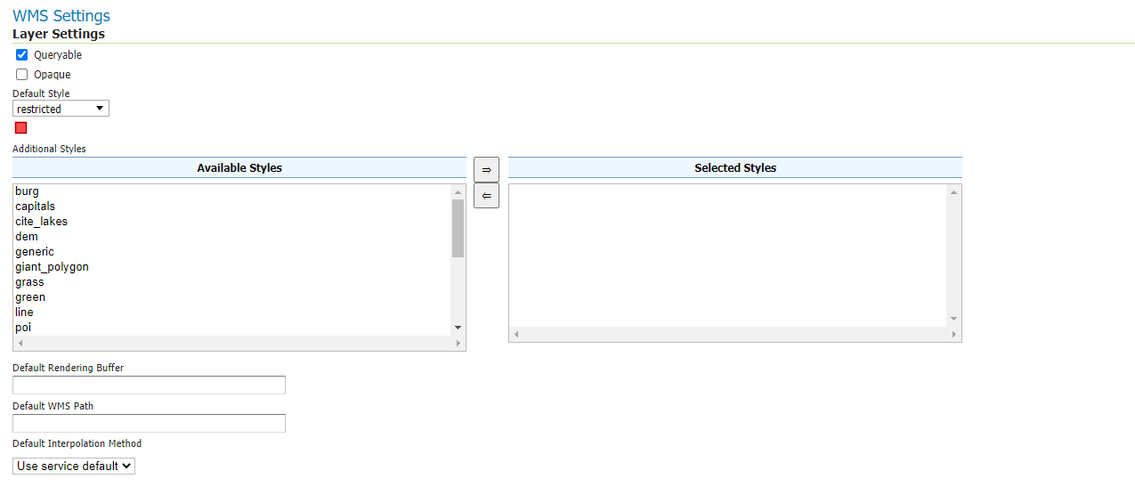
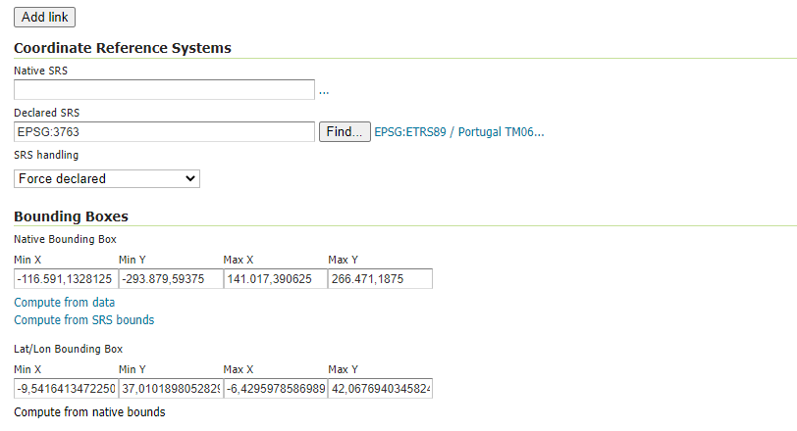
Graduation IN Informatics engineering
■ 3.3. Geoserver
System Integration
Styles. How the information obtained from the shapefile should appear on the map
Forcing the coordinate system type
@2020/2021 – António Marques – 21674 and Nelson Campinho – 21751 – WebSIG viewer for geograpic data
- 29 -

Slide 30
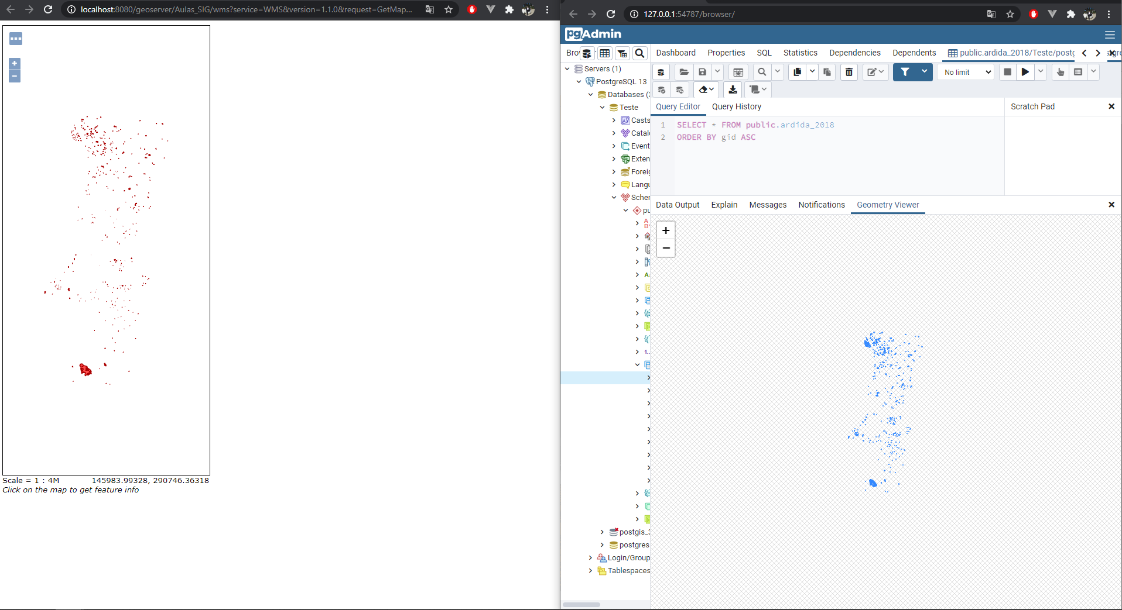
Graduation IN Informatics engineering
■ 3.3. Geoserver
System Integration
The result of the editing is as follows on the image. On the left is the layer created on the geoserver (that can be imported and displayed on a map) and on the right is the query result on the same table that is being used to create the layer on the geoserver.
@2020/2021 – António Marques – 21674 and Nelson Campinho – 21751 – WebSIG viewer for geograpic data
- 30 -

Slide 31
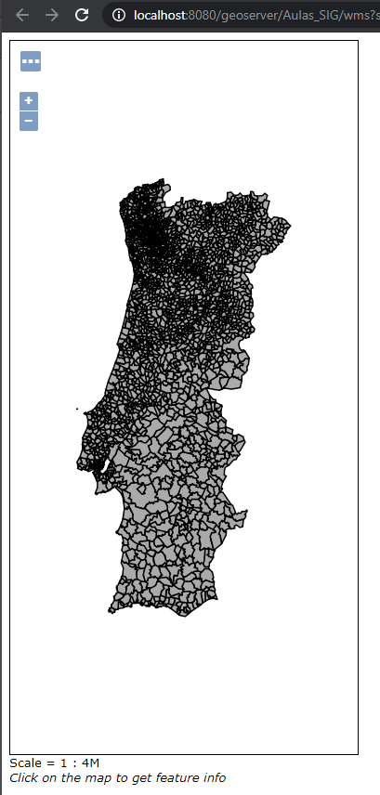
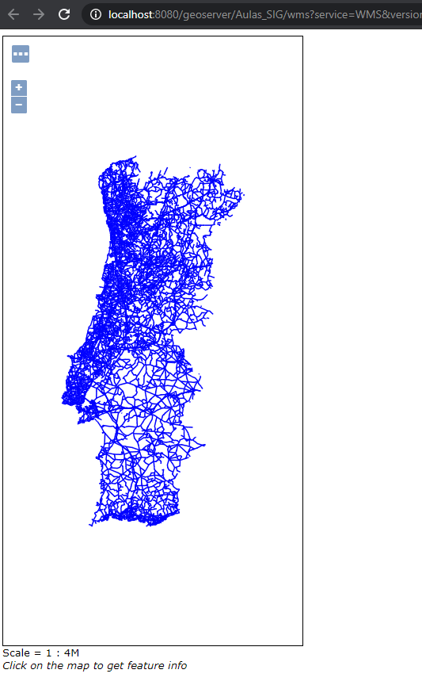
Graduation IN Informatics engineering
■ 3.3. Geoserver
System Integration
Shapefiles refering to countries
Shapefile refering to Portugal’s road network
@2020/2021 – António Marques – 21674 and Nelson Campinho – 21751 – WebSIG viewer for geograpic data
- 31 -

Slide 32
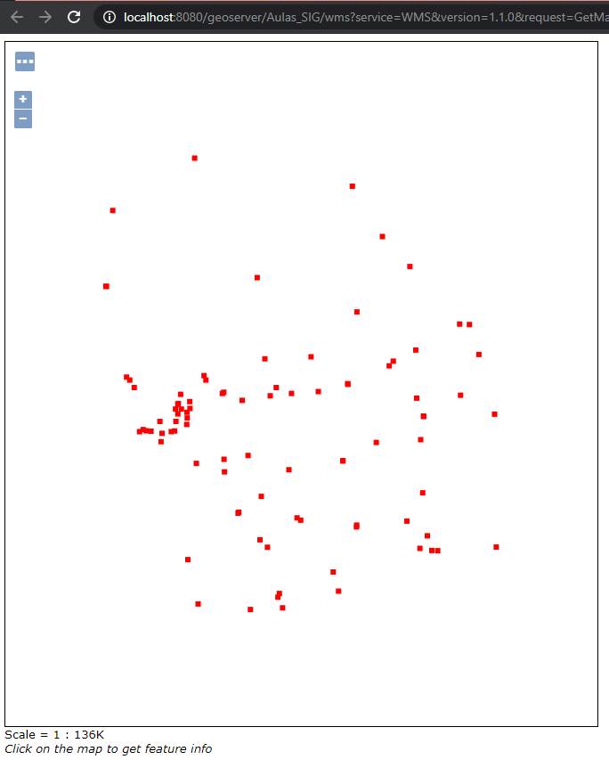
Graduation IN Informatics engineering
■ 3.3. Geoserver
System Integration
Shapefile refering to water spots
@2020/2021 – António Marques – 21674 and Nelson Campinho – 21751 – WebSIG viewer for geograpic data
- 32 -

Slide 33
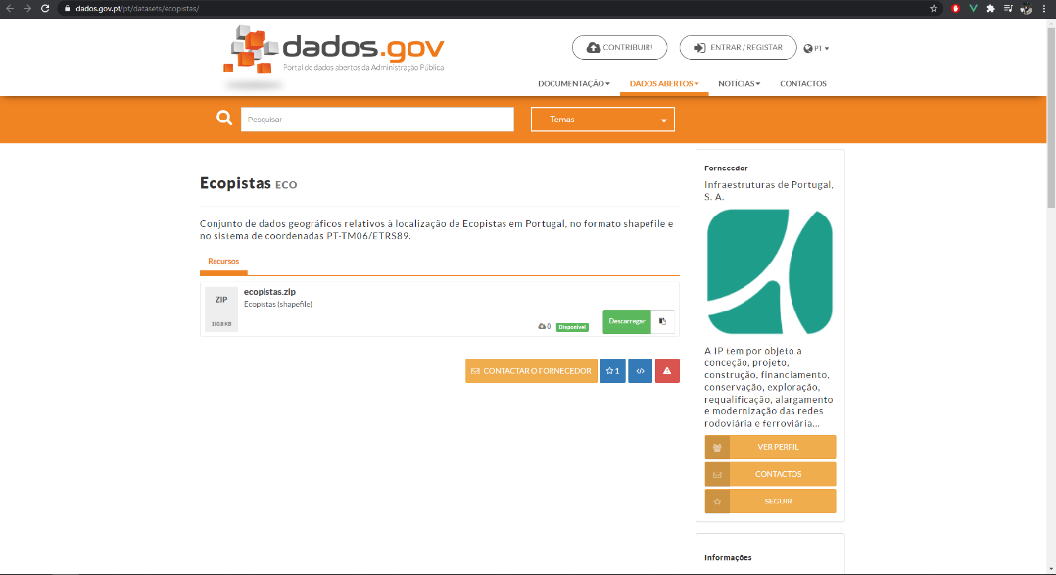
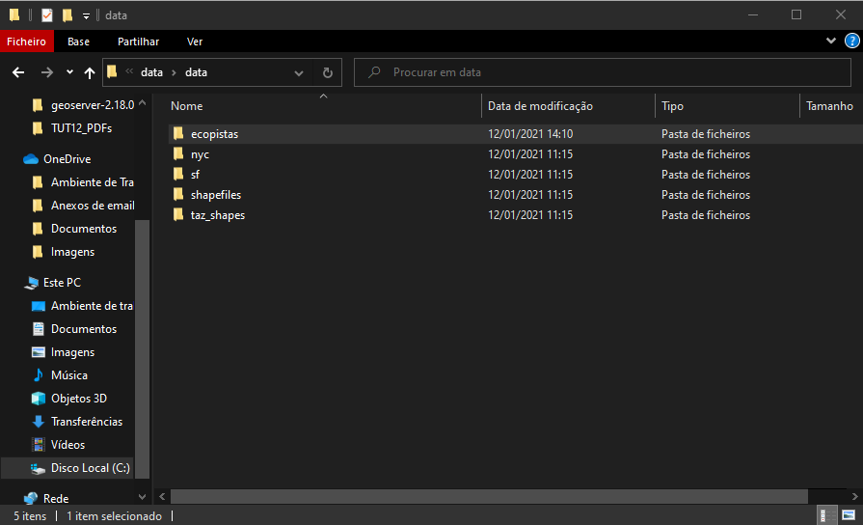
Graduation IN Informatics engineering
■ 3.3. Geoserver
System Integration
Downloading shapefile refering to ‘Ecopistas’
@2020/2021 – António Marques – 21674 and Nelson Campinho – 21751 – WebSIG viewer for geograpic data
- 33 -

Slide 34
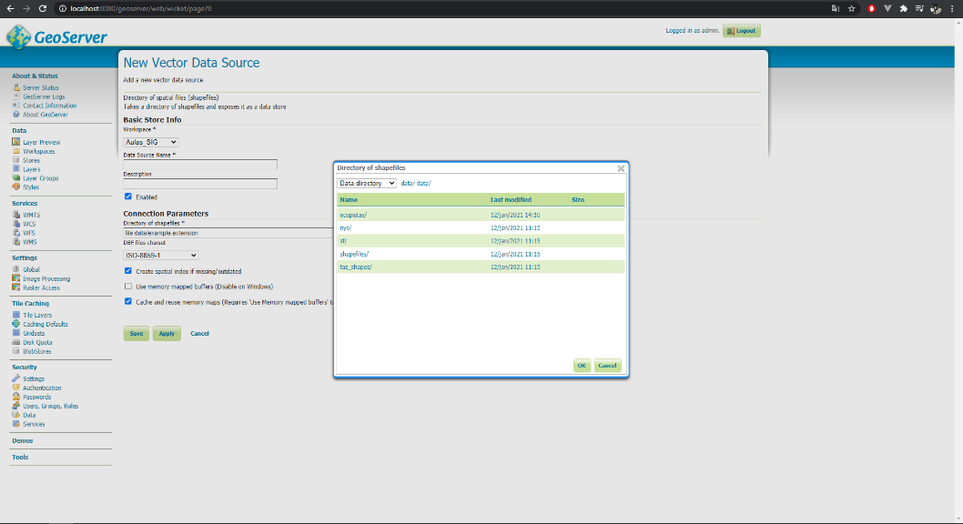
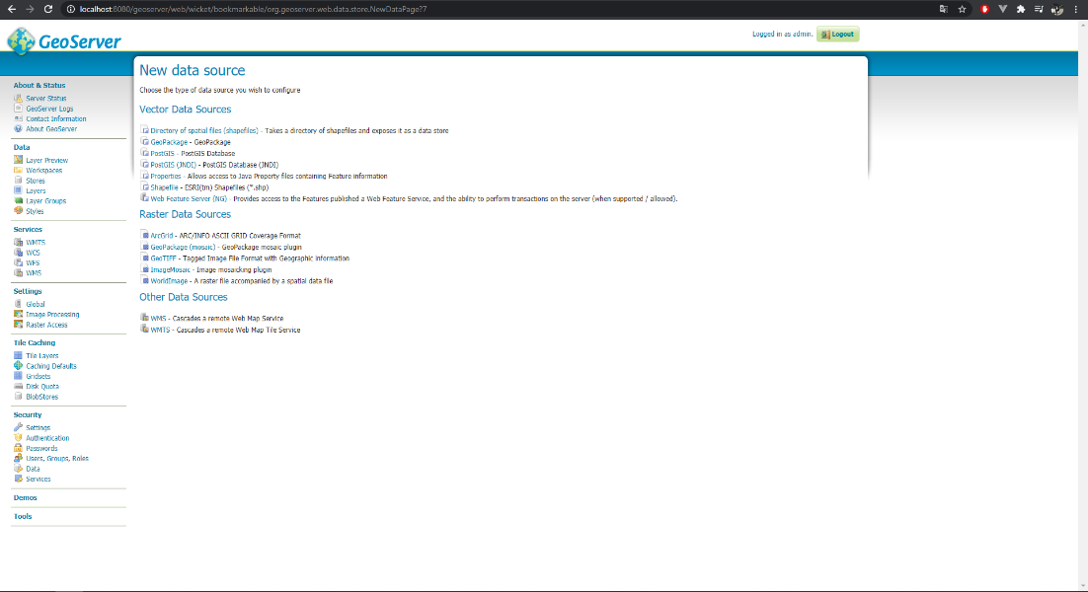
Graduation IN Informatics engineering
■ 3.3. Geoserver
System Integration
Adding new shapefile to Geoserver to create a new layer
@2020/2021 – António Marques – 21674 and Nelson Campinho – 21751 – WebSIG viewer for geograpic data
- 34 -

Slide 35
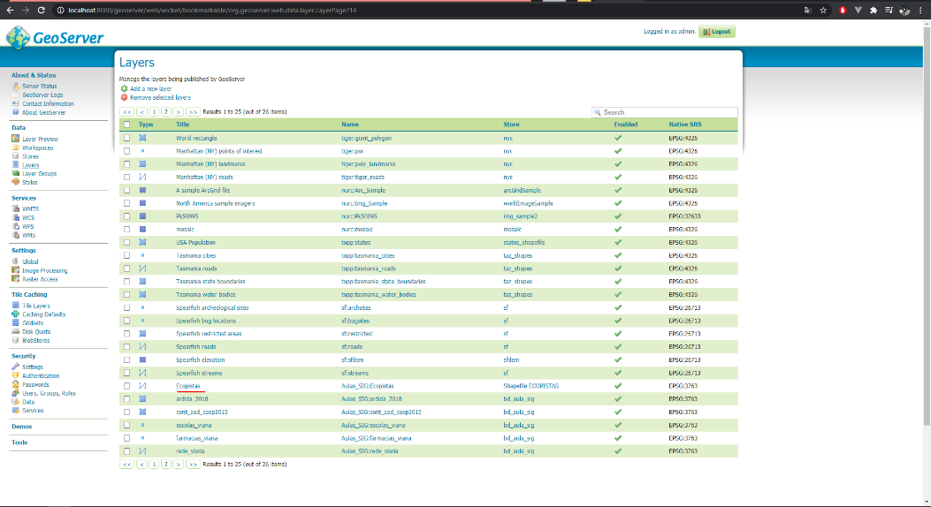
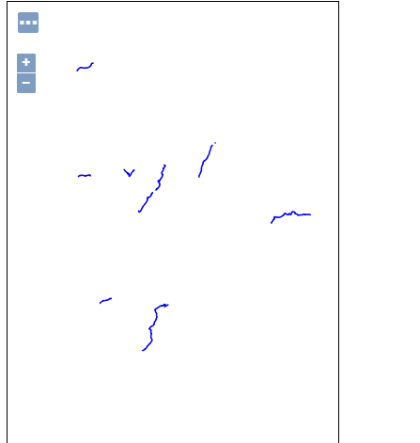
Graduation IN Informatics engineering
■ 3.3. Geoserver
System Integration
Layer created and visual representation of the layer.
@2020/2021 – António Marques – 21674 and Nelson Campinho – 21751 – WebSIG viewer for geograpic data
- 35 -

Slide 36


Graduation IN Informatics engineering
■ 3.3. Geoserver
System Integration
On this example it is obtained a WMS file to create a layer on Geoserver.
WMS(Warehouse management system) allows to obtain information, via URL, without the need of files. Like this it is possible to obtain geospacial information to render layers without having shapefiles.
@2020/2021 – António Marques – 21674 and Nelson Campinho – 21751 – WebSIG viewer for geograpic data
- 36 -

Slide 37


Graduation IN Informatics engineering
■ 3.3. Geoserver
System Integration
Creating a new layer (store) using WMS instead of shapefile.
URL of WMS relating to the information for the new layer about biosphere reserves.
@2020/2021 – António Marques – 21674 and Nelson Campinho – 21751 – WebSIG viewer for geograpic data
- 37 -

Slide 38

Graduation IN Informatics engineering
■ 3.3. Geoserver
System Integration
On the following image is represented the layer created using WMS.
@2020/2021 – António Marques – 21674 and Nelson Campinho – 21751 – WebSIG viewer for geograpic data
- 38 -

Slide 39



Graduation IN Informatics engineering
■ 4. OpenLayers Example
System Integration
OpenLayers is an open-source Javascript program that allows easy incorporation of dynamic maps into a webpage. Here it is shows a small example on how to create show a small map into a web page.
@2020/2021 – António Marques – 21674 and Nelson Campinho – 21751 – WebSIG viewer for geograpic data
- 39 -

Slide 40
Graduation IN Informatics engineering
■ 5. Final Project – WebSIG viewer
System Integration
The main objective of the project is to create a WebSIG viewer that allows the user to create new pieces of geospacial data (these being throught points, lines or polygons) and saving the information into a database that supports geospacial data. It should also allow to display multiple types of information, provided by layers rendered using Geoserver that is using geospacial data from shapefiles, WMS URL’s and even data that the user has been inserting.
The view should allow the user to edit and delete inserted data.
@2020/2021 – António Marques – 21674 and Nelson Campinho – 21751 – WebSIG viewer for geograpic data
- 40 -

Slide 41
Graduation IN Informatics engineering
■ 5.1. PostgreSQL, Geoserver and openstreetmaps
System Integration
For the execution of the project it was considered PostgreSQL database and PostGIS to perform geospacial operation that involve geometric data types. Alongside PostgreSQL it was also used Geoserver to create layers to later being called into the map according to the users needs.
The map provider that is going to be used is openstreetmaps which is incorporated on the project with the assistance of Leaflet. Leaflet allows to create different tiles which represente different ways of showing the same map (grayscale, satellite, etc).
@2020/2021 – António Marques – 21674 and Nelson Campinho – 21751 – WebSIG viewer for geograpic data
- 41 -

Slide 42

Graduation IN Informatics engineering
■ 5.1. PostgreSQL, Geoserver and openstreetmaps
System Integration
Importing different types of openstreetmap to provide to the user multiple maps according to the preferences
@2020/2021 – António Marques – 21674 and Nelson Campinho – 21751 – WebSIG viewer for geograpic data
- 42 -

Slide 43

Graduation IN Informatics engineering
■ 5.1. PostgreSQL, Geoserver and openstreetmaps
System Integration
Alonside the types of map options to display for the user it is also provided multiple layers that can be displayed on the map, related to the examples explored in previous slides. These layers can be about a road network, existing schools, etc. To do so it was created a variable ‘overlays’ that would be use to mount a controls icon (default of Leaflet).
Data is fetched using wms where the URL corresponds to geoserver location. The geoserver as verified on previous slides contains rendered geospacial information that is converted into a layer
@2020/2021 – António Marques – 21674 and Nelson Campinho – 21751 – WebSIG viewer for geograpic data
- 43 -

Slide 44


Graduation IN Informatics engineering
■ 5.1. PostgreSQL, Geoserver and openstreetmaps
System Integration
By default openstreetmaps uses Satellite option. By creating the control panels the user has access to other options.
@2020/2021 – António Marques – 21674 and Nelson Campinho – 21751 – WebSIG viewer for geograpic data
- 44 -

Slide 45


Graduation IN Informatics engineering
■ 5.1. PostgreSQL, Geoserver and openstreetmaps
System Integration
Map options
Layer options
@2020/2021 – António Marques – 21674 and Nelson Campinho – 21751 – WebSIG viewer for geograpic data
- 45 -

Slide 46


Graduation IN Informatics engineering
■ 5.1. PostgreSQL, Geoserver and openstreetmaps
System Integration
Leaflet also allows the incorporation of a tool bar to allow users to create points(markers), draw lines and polygons. These features are going to be implemented on openstreetmaps and is going to be used to store data into PostgreSQL.
Creates tool bar into the map
drawControl
@2020/2021 – António Marques – 21674 and Nelson Campinho – 21751 – WebSIG viewer for geograpic data
- 46 -

Slide 47

Graduation IN Informatics engineering
■ 5.1. PostgreSQL, Geoserver and openstreetmaps
System Integration
To the option create on bottom left drawControl of Leaflet is created functions with different features considering each option in create option.
@2020/2021 – António Marques – 21674 and Nelson Campinho – 21751 – WebSIG viewer for geograpic data
- 47 -

Slide 48
Graduation IN Informatics engineering
■ 5.1. PostgreSQL, Geoserver and openstreetmaps
System Integration
CreateModal function creates a small pop up window to insert data that, when submited, is sent into PostgreSQL database.
Regarding the creation of a marker, when a place on the map is clicked the modal appears allowing the user to type about what that marker refers too. After submiting, the new marker information is saved on the database and the page refreshes to update the information.
@2020/2021 – António Marques – 21674 and Nelson Campinho – 21751 – WebSIG viewer for geograpic data
- 48 -

Slide 49


Graduation IN Informatics engineering
■ 5.1. PostgreSQL, Geoserver and openstreetmaps
System Integration
All markers displayed were manually inserted. By clicking on each marker, the information written by the user appear on a small popup component.
The colors of the marker depend on the type selected when creating the marker.
@2020/2021 – António Marques – 21674 and Nelson Campinho – 21751 – WebSIG viewer for geograpic data
- 49 -

Slide 50

Graduation IN Informatics engineering
■ 5.1. PostgreSQL, Geoserver and openstreetmaps
System Integration
The web page not only allows the creation of markers but also routes (lines) and areas (polygons). Each of this creations have their own option on the draw control panel. The information for routes and areas, like the marker, is inserted by the user and later sent to the database.
@2020/2021 – António Marques – 21674 and Nelson Campinho – 21751 – WebSIG viewer for geograpic data
- 50 -

Slide 51

Graduation IN Informatics engineering
■ 5.1. PostgreSQL, Geoserver and openstreetmaps
System Integration
Routes and areas colors also change depending on the type.
@2020/2021 – António Marques – 21674 and Nelson Campinho – 21751 – WebSIG viewer for geograpic data
- 51 -

Slide 52

Graduation IN Informatics engineering
■ 5.1.1. Database Connection and Inserting data
System Integration
In order to being able to insert and utilize the data from PostgreSQL it is required a connection. Using PHP and PDO the connection to a PostgreSQL instance was performed
@2020/2021 – António Marques – 21674 and Nelson Campinho – 21751 – WebSIG viewer for geograpic data
- 52 -

Slide 53

Graduation IN Informatics engineering
■ 5.1.1. Database Connection and Inserting data
System Integration
Since the modal stucture is a form, when the data is submited all form fields information is sent to an endpoint where the data is inserted into the respective places.
Marker insertion
Indicates to the database that this is a point
Inserted information
Coordinate system type
@2020/2021 – António Marques – 21674 and Nelson Campinho – 21751 – WebSIG viewer for geograpic data
- 53 -

Slide 54

Graduation IN Informatics engineering
■ 5.1.1. Database Connection and Inserting data
System Integration
Line insertion
Indicates to the database that this is a line
Inserted information
Coordinate system type
@2020/2021 – António Marques – 21674 and Nelson Campinho – 21751 – WebSIG viewer for geograpic data
- 54 -

Slide 55

Graduation IN Informatics engineering
■ 5.1.1. Database Connection and Inserting data
System Integration
Polygon insertion
Indicates to the database that this is a Polygon
Inserted information
Coordinate system type
@2020/2021 – António Marques – 21674 and Nelson Campinho – 21751 – WebSIG viewer for geograpic data
- 55 -

Slide 56

Graduation IN Informatics engineering
■ 5.1.2. Getting inserted data
System Integration
To obtain the inserted data and display it on the map, instead of using queries to fetch the information from the database, it was used Geoserver. Geoserver handles de construction of layer related to the inserted information (creates a layer for markers, lines and areas separately) and throught WMS it is incorporated into openstreetmaps.
@2020/2021 – António Marques – 21674 and Nelson Campinho – 21751 – WebSIG viewer for geograpic data
- 56 -

Slide 57



Graduation IN Informatics engineering
■ 5.1.2. Getting inserted data
System Integration
Marker Popup
Areas have their total area calculated
Polyline Popup
Lines have their length calculated
Polygon Popup
@2020/2021 – António Marques – 21674 and Nelson Campinho – 21751 – WebSIG viewer for geograpic data
- 57 -

Slide 58


Graduation IN Informatics engineering
■ 5.1.3. Removing inserted data
System Integration
When clicking on a marker, line or area created a popup appear with more details about the item. At the bottom of the popup there is a remove button that, when pressed executes a query that removes the information about the item from the database
Removes Marker
Removes Line
@2020/2021 – António Marques – 21674 and Nelson Campinho – 21751 – WebSIG viewer for geograpic data
- 58 -

Slide 59

Graduation IN Informatics engineering
■ 5.1.3. Removing inserted data
System Integration
Removes area
@2020/2021 – António Marques – 21674 and Nelson Campinho – 21751 – WebSIG viewer for geograpic data
- 59 -

Slide 60
Graduation IN Informatics engineering
■ 6. Difficulties & future features
System Integration
Difficulties: ■ Transform coordinates to be inserted in postgres
Future features:
■ Insert search bar
@2020/2021 – António Marques – 21674 and Nelson Campinho – 21751 – WebSIG viewer for geograpic data
- 60 -
Notes:
Tiago 1º Luís 2º

Slide 61
Graduation IN Informatics engineering
■ 7. Conclusion
System Integration
By integrating multiple platforms and tools, for example by integrating a PostgreSQL database with geospacial data features into Lealeft and an open-source map provider alongisde Geoserver, it was possible to build a functioning WebSIG that not only is able to call different layers and build them on top of the existing map but also is able to provide features for users to use.
These features, like inserting, deleting and visualyzing data, make the WebSIG a powerful information provider tool to be provided to everyone.
@2020/2021 – António Marques – 21674 and Nelson Campinho – 21751 – WebSIG viewer for geograpic data
- 61 -

Slide 62
Graduation IN Informatics engineering
■ 8. Bibliography and Web References
System Integration
■ Leaflet: https://leafletjs.com/examples/geojson/
■ OpenLayers: https://openlayers.org/ ■ Geoserver: http://geoserver.org/ ■ PostgreSQL: https://www.postgresql.org/
■ Quantum GIS: https://www.qgis.org/en/site/
■ dados.gov: https://dados.gov.pt/pt/
@2020/2021 – António Marques – 21674 and Nelson Campinho – 21751 – WebSIG viewer for geograpic data
- 62 -

Slide 63
WebSIG Viewer For Geographic Data
Graduation IN Informatics engineering
WebSIG viewer for geographic data
■ Course Unit: System Integration
António Marques - 21674
Nelson Campinho - 21751
■ Coordinator: Prof. Coordenador Jorge Ribeiro
Instituto Politécnico de Viana do Castelo
Escola Superior de Tecnologia e Gestão
www.ipvc.pt
School Year: 2020/2021
Orientation
Coordinator: Prof. Coordenador Jorge Ribeiro
21674 – António José Ribeiro Marques
21751 – Nelson Filipe Faria Campinho
Graduation in Informatics Engineering | Escola Superior de Tecnologia e Gestão| Course Unit: System Integration | School Year: 2020/2021

